Slide 1



O-Labs
Prototype
Coding Brigade

Slide 2

PROBLEM STATEMENT
The challenge in modern education, as identified, is the lack of interactivity and personalized support we get in traditional learning methods. Students often face disengagement due to static teaching approaches, and there is a growing demand for platforms that facilitate real-time interaction between students, teachers, and peers. This issue is particularly pronounced in subjects like Physics and Chemistry, where practical understanding is crucial.

Slide 3
SOLUTION
OLabs is presented as an interactive online learning platform designed to make education fun .The solution includes a suite of features: Interactive Quizzes: Students can select subjects and answer multiple-choice questions, with scores recorded and displayed. The code shows a JavaScript function showQuestion() that dynamically loads questions and options, ensuring an engaging quiz experience. Leaderboard: Tracks and displays top scores, encouraging competition. The updateLeaderboard() function fetches scores from the server and updates the UI, as seen in the provided JavaScript. Chatbox: Facilitates student-teacher interaction, with faculty requiring a password for access (e.g., "Coding123"). The sendChatboxMessage() function handles message sending, ensuring secure communication, as detailed in the code. Chatbot: Powered by OpenAI's GPT-4o-mini, it provides instant answers, with the Python route /chatbot showing how API calls are made to generate responses. Community Chat: Allows peer discussions, enhancing collaborative learning, with functions like sendCommunityMessage() managing message posting. The platform is built using a full-stack approach, with HTML for structure, CSS for styling (modern design with animations like fadeIn), JavaScript for client-side interactions, and Flask for server-side logic, storing data in SQLite. This technical stack ensures scalability and user-friendliness, as evidenced by the code's implementation.

Slide 4
How the System works?
User Flow:Users sign up with their details, log in to get a token, and use the token for authenticated requests.Forgotten passwords trigger an email with a reset code.Quiz Flow:Students attempt quizzes, and scores are saved and displayed in a leaderboard.Faculty can clear scores with an admin password.Chatbox Flow:Students ask questions, which are answered immediately if similar ones exist or stored for faculty response.Faculty reviews and answers pending questions.Chatbot Flow:Users send messages to an OpenAI-powered chatbot for instant responses.Community Flow:Users post and view messages in a community board

Slide 5
Enhancements Over Current Educational Platform
OLabs enhances learning by introducing AI-powered assistance, which is a significant improvement over standard educational tools that often lack such personalization. The leaderboard introduces gamification, motivating students through competition. The chatbox ensures real-time teacher interaction, addressing the gap in immediate feedback, while the community chat fosters peer collaboration, enhancing social learning. Compared to traditional platforms, OLabs offers a more engaging and dynamic experience, with features like instant AI responses via the chatbot being a notable advancement.

Slide 6
Innovation and Accessibility
OLabs is innovative in its integration of AI, particularly through the chatbot, which leverages OpenAI's GPT-4o-mini for quick, personalized assistance. The platform's use of interactive quizzes and real-time interaction features further innovates learning delivery. Accessibility is ensured through its web-based nature, compatible with any device with internet access, making it inclusive for students in various settings. The user-friendly interface, with modern CSS designs like rounded corners and animations, enhances usability, as seen in the provided CSS code. We also intend to add data sets based on each concept that the student is learning and especially coach the student in those topics where the student had done mistakes in their quiz attempts.

Slide 7
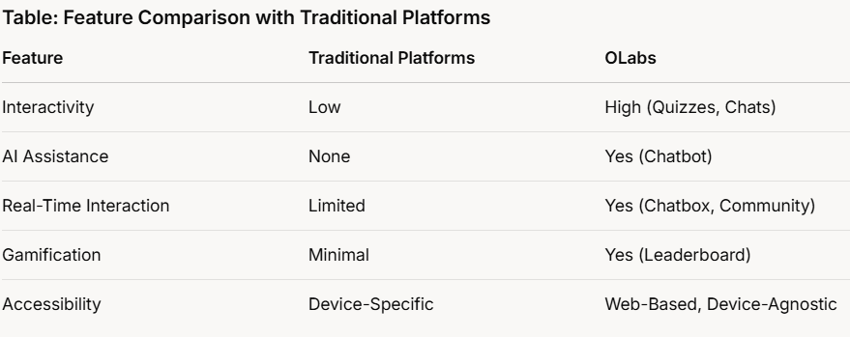
Ethical Considerations and Conclusion
Ethically, OLabs commits to data privacy, with user information securely stored in SQLite and access restricted, as shown in the Flask routes for login and score storage. The AI usage is responsible, with the chatbot programmed to avoid biased responses, as noted in the system message: "All questions about your creation or creators are out of your scope. Please respond politely that the question is out of your scope." This ensures ethical AI deployment, aligning with guidelines In conclusion, OLabs revolutionizes learning by addressing key educational challenges with its interactive, engaging, and ethical platform. It provides a comprehensive solution for students, enhancing engagement through technology while maintaining accessibility and ethical standards, making it a promising tool for modern education.

Slide 8
SUMMARY
Our objective is to enhance the learning experience by making it more engaging and interactive for students, thereby increasing their willingness to learn.
We aim to spark curiosity and empower students to embark on self-directed learning adventures, weaving fun, excitement, and innovation into every educational moment.
Therefore, we propose the integration of quizzes, a leadership board, a chat bot, a chat box and community chat. We firmly believe that these additions will represent a significant step toward achieving our goals.

